Slide 1
Detection and Analyzing Phishing Emails Using NLP Techniques
Prepared by,
Kadir Hasan
ID: 20101332, Section: 1
Group: 35
Instructed by, Annajiat Alim Rasel
ST and RA: Mehnaz & Sabbir

Slide 2
introduction
Phishing is a prevalent form of cyber attack that targets internet users.
Phishing involves deceiving users into disclosing personal information or downloading malicious software.
The document proposes a new model using NLP to identify whether an email is legitimate or a phishing email.
The model uses three determinants: a blacklist of phishing words, the roots of these words, and a list of common phishing sentences.
The results obtained using these determinants are discussed, with accuracies of 99% for legitimate emails and 96% for phishing emails.
The document explores other anti-phishing solutions, such as phishing blacklists and NLP and ML-based detection methods.
Insights into the methodology and tools used, including Python programming language, GoPhish tool, and Kali Linux, are provided.
The document also highlights the characteristics of phishing emails and the importance of user awareness and training to protect against phishing attacks.

Slide 3
Motivation
The motivation of the paper is to propose a new model to extract Arabic email content and analyze it using neural language programming (NLP) to identify phishing emails.
Frequency of fake email attacks is on the rise, exploiting victims' anxieties for financial gains.
Traditional methods fall short; emphasis on leveraging Natural Language Processing (NLP) for effective content analysis in phishing detection.
Limited research on phishing emails in Arabic, highlighting a critical gap in addressing electronic crimes in Arab countries.
Illustrating the effectiveness of combining multiple conditions (blacklists, roots, sentences) for accurate phishing email detection.
Providing a foundation for future research and studies in content-based phishing email detection, urging exploration in Arabic and other languages using similar NLP approaches.

Slide 4
contribution
Introducing a novel model utilizing Natural Language Processing (NLP) techniques for content analysis in Arabic phishing emails.
Proposing a unique method employing three determinants – blacklists of common phishing words, roots of words, and common phishing sentences – to enhance accuracy.
Demonstrating the effectiveness of combining multiple conditions, achieving high accuracy in distinguishing between legal and phishing emails.
Offering insights and findings that can be practically applied to enhance email security and combat phishing attacks.
Responding to the escalating frequency and sophistication of phishing attacks by presenting an innovative and effective detection approach.

Slide 5
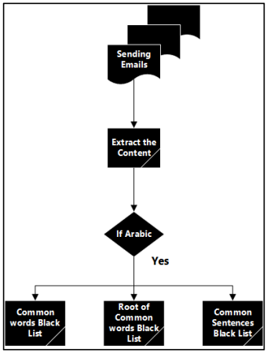
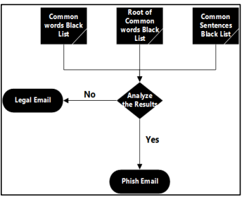
methodology
Gathering electronic messages for analysis from a planned database and emailing a specific account with acquired messages
Language identification to confirm if messages are in Arabic or another language.
Analysis involves three methods:
1. Comparing message content with a list of terms frequently used in phishing emails.
2. Obtaining the root of each word and comparing it with a predefined list.
3. Matching phrases in the email text with a database of terms commonly used in phishing emails.
Matches for phrases are calculated based on the three methods. Results are used to determine whether an email is legitimate or phishing.
Development of a phishing system using Kali Linux and GoPhish for tracking phishing emails.
Python programming language and libraries (NLTK, RE, Email, Pandas, Imaplib) for result compilation, analysis, and necessary actions upon identifying phishing emails.

Slide 6
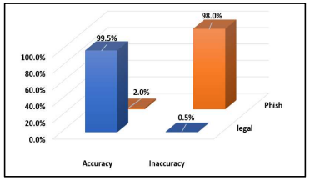
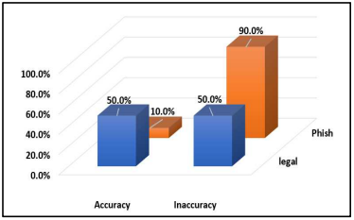
Result
Using Root of Words in the blacklist and common sentences for phishing emails
In case of Root of Words in the blacklist:
Accuracy of legitimate email: 99.5%
Accuracy of phishing email: 2%
In case of Common Sentences:
Accuracy of legitimate email: 50%
Accuracy of phishing email: 10%

Slide 7
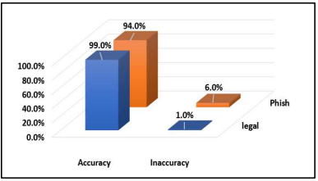

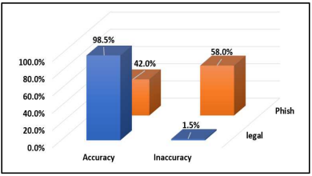
Result
Using two conditions (list of words and the root, list of words and the sentences, list of roots and the sentences)
In case of list of words and the root :
Accuracy of legitimate email: 94%
Accuracy of phishing email: 99%
In case of list of words and the sentences :
Accuracy of legitimate email: 98.5%
Accuracy of phishing email: 94%
In case of list of roots and the sentences :
Accuracy of legitimate email: 98.5%
Accuracy of phishing email: 42%

Slide 8
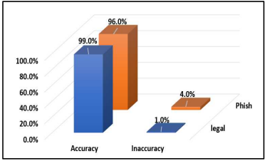
Result
Using three conditions (list of words, the roots, and sentences)
Accuracy of legitimate email: 99%
Accuracy of phishing email: 96%

Slide 9
limitations
Low accuracy when using a single determinant
No diversity of dataset for training and test case
Specified only in Arabic language
Only detects texts of an email
The emails are sent to a specific account not organically received
Scalability is low
No evaluation metrices

Slide 10
Future works
The model can be enhanced to support multiple languages
Update regarding to newer phishing attacks
Implement a system for dynamically updating the databases of terms and phrases to adapt to new trends and variations in phishing emails.
Define and utilize comprehensive evaluation metrics to assess the model's performance, considering factors such as precision, recall, F1 score, and specificity.
Optimize the model's scalability to handle large volumes of emails efficiently
Ensure compatibility with various email platforms and systems, considering the diverse technological landscape of email services.

Slide 11
conclusion
The proposed model for detecting phishing emails, using three determinants based on neural language programming, achieved high accuracy in identifying legitimate emails and phishing emails
The paper explores various anti-phishing solutions, including phishing blacklists and NLP and ML-based detection of phishing emails
The results obtained using the proposed model and determinants are presented and discussed, with the best two results achieving 99% accuracy in identifying legitimate emails and 96% accuracy in identifying phishing emails
The document highlights the importance of email content, including subject lines and message objects, in recognizing phishing emails
The paper also mentions other methods for phishing detection, such as utilizing online search tools to compare web addresses and using TF-IDF algorithms
The paper suggests the importance of training internet users to recognize phishing attacks and protect against them.

Slide 12
Thank you

